Slide 1


Department of Computer Science & Engineering
CMR TECHNICAL CAMPUS
An UGC Autonomous Institute
Accredited by NBA & NAAC with A Grade
Approved by AICTE, New Delhi and Affiliated to JNTU, Hyderabad
Project Stage-I: Review-I
SiteGuard AI: Automated Construction Safety & Compliance System
BATCH NO : 16
Project Guide & Project Coordinator: B. Sekhar
Assistant Professor,CSE Department
Batch members:
Abdul Mubashir 237R1A05P0
Abdul Majeed 237R1A05K3
K Manohar 237R1A05M7

Slide 2

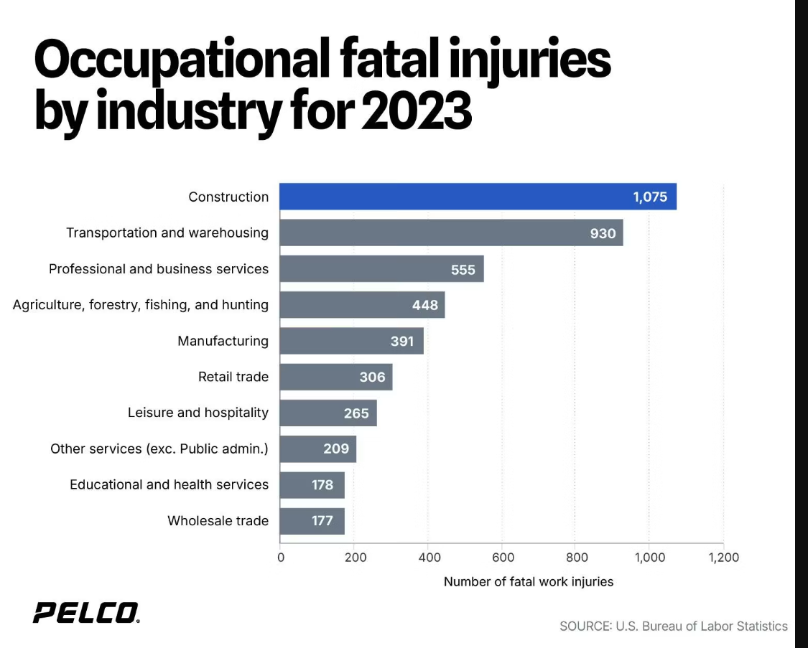
Introduction
The Problem
Manual PPE checks — slow, inconsistent, no audit trail
No real-time restricted zone enforcement
Paper delivery records — easily forged or lost
Material inflow not digitally recorded
Hazard reports verbal only — no categorization

Slide 3
Literature Review
Reference
Technique
Contribution
Limitation
Fang et al. (2018)
CNN
Worker & PPE detection on site
Helmet only
Wu et al. (2019)
Faster R-CNN
Real-time safety detection
High compute cost
Nath et al. (2020)
YOLOv3
Near real-time PPE detection
Occlusion errors
Barro-Torres et al. (2021)
OpenCV + SVM
Zone monitoring via cameras
No alert system
Recent (2022–24)
YOLOv8
Improved speed + accuracy
Single-module only
Key Gap:
No prior work integrates PPE detection + zone monitoring + delivery verification + hazard reporting into one unified platform. YOLOv8 is the current state-of-the-art — our system builds on it.
Notes:
Replace paper references with your actual cited papers from your report. Key message: prior work focuses on single tasks only.

Slide 4

Problem Definition
Manual safety inspection cannot keep pace with the causes of fatal accidents on Indian construction sites. Falls from height, structural collapse, and electrocution together account for the overwhelming majority of deaths — all conditions this platform is designed to detect and flag before they escalate.
No automated, real-time PPE compliance enforcement at entry points
Restricted hazardous zones (crane, excavation, high-voltage) go unmonitored
Delivery-count fraud between vendors and supervisors goes undetected
Hazard reports are informal, uncategorized, with no audit trail
Source: Insuropedia / industry accident analysis, 2013–2016 dataset
04

Slide 5
Objectives
Primary Objective:
Develop an automated, AI-powered construction site monitoring platform that improves safety, prevents delivery fraud, records material inflow, and centralizes site data — without requiring additional inspection staff.
Detect PPE violations (helmet, vest) at the entry gate in real time using YOLOv8
Enable supervisors to log material type (cement/sand/bricks/steel) and quantity per delivery
Monitor restricted/hazardous zones and alert supervisors on unauthorized entry
Allow workers to submit hazard reports with AI-assisted categorization
Build a reusable shared camera pipeline to minimise hardware cost
Display all metrics on a unified, role-based dashboard (Admin + Supervisor)
Notes:
Read objectives 01–04 (safety focus), then 05–08 (operations + scalability). Mention that objectives 04 and 05 together solve the delivery fraud problem while keeping AI claims honest.

Slide 6
Proposed System
01
02
PPE Detection
Zone Monitoring
Entry-gate helmet/vest verification via two-stage YOLOv8 detect-then-classify pipeline.
Polygon-based restricted-zone breach detection with real-time supervisor alerts.
04
05
06
Delivery Verification
Hazard Reporting
Central Dashboard
AI vehicle count vs. manual report, with pattern-based fraud escalation to Admin only.
Worker-submitted hazards with rule-based AI categorization.
Live KPIs, compliance rate, violations, and escalations in one view.
05

Slide 7
Methodology
1
2
3
Video Input
Frame Extraction
YOLOv8 Detection
→
→
Live gate camera feed or recorded video file — the pipeline treats both identically.
OpenCV samples frames at a fixed interval for processing.
Detects persons, PPE items, vehicles, and equipment per frame with confidence thresholding.
4
5
6
Rule-Based Logic
Backend + Database
Dashboard + Alerts
→
→
Custom logic determines violations, zone breaches, and vehicle counts from raw detections.
FastAPI logs every event to PostgreSQL as an immutable audit record.
React dashboard updates live; escalations route to the correct role automatically.
07

Slide 8
Analysis
Existing construction site monitoring relies heavily on manual inspections, which are time-consuming and prone to human error.
Safety violations, such as missing PPE and unauthorized zone entry, may not be detected immediately, increasing the risk of workplace accidents.
Manual verification of delivery vehicle counts can lead to discrepancies and reduce operational transparency.
Existing AI solutions generally focus on single tasks (e.g., PPE detection) rather than providing an integrated construction site management platform.
The proposed system combines computer vision, AI, and centralized data management to automate safety monitoring, improve compliance, and support faster decision-making.
Real-time monitoring and dashboard analytics enable supervisors to respond quickly to safety incidents and operational issues.

Slide 9
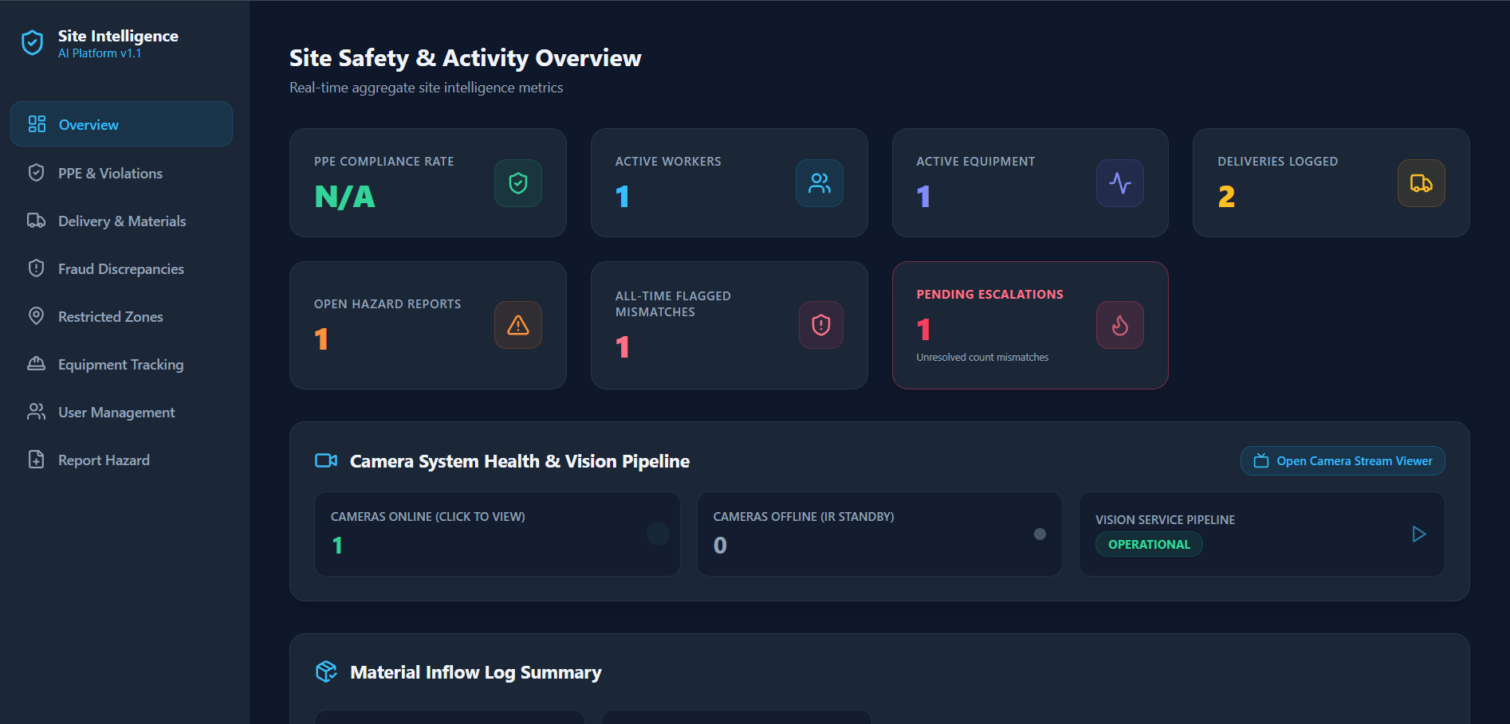
Expected Output

